Slide 1
The Healthcare Blockchain
RX 319
Introduction to Healthcare Analytics

Slide 2
Learning Objectives
Describe methods that allow organizations to share health data.
Explain what a blockchain is.
Explain a blockchain’s use in healthcare.
2

Slide 3





Sharing EHRs between organizations
Primary Care Physician
Hospital
EHR Database
Health Department
Specialty Physician
Community Pharmacy
3

Slide 4
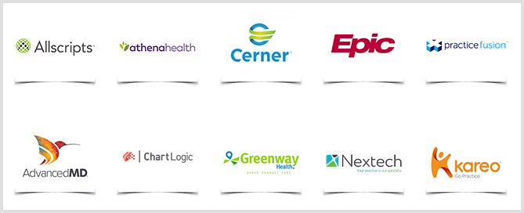
How is the data stored?
4

Slide 5
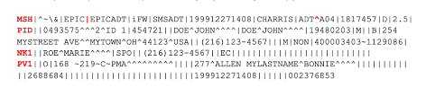
The HL7 Protocol
A way to represent health data for computers
Different EHR databases can send and receive data
5

Slide 6

Healthcare Data Security
EHR Database
Community Pharmacy
Hospital
The Blockchain -> More secure data?
6
Cybercriminals

Slide 7
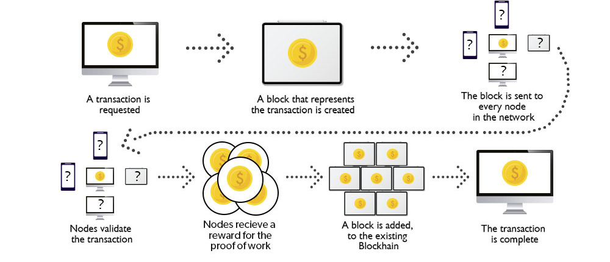
How does the blockchain work?
Key Point: Instead of the data being stored in one database, the data is stored in lots of people’s computers
Difficult for someone to change the data
May be easy to access the data (must be encrypted)
7
Source: geeksforgeeks.com. “How Does the Blockchain Work?” https://www.geeksforgeeks.org/how-does-the-blockchain-work/

Slide 8
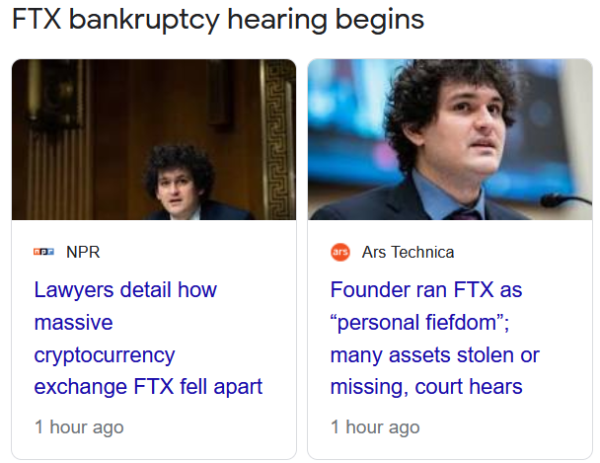

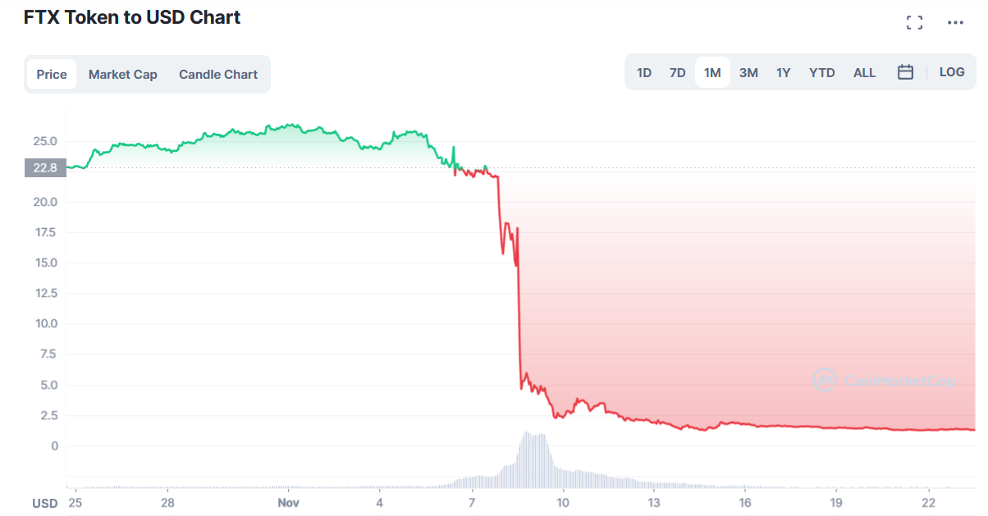

Cryptocurrency
8

Slide 9
The Blockchain for Healthcare (Future)
Currently in experimental phase
EHR, pharmaceutical supply chain data, and other healthcare data can be stored on the blockchain
Instead of transactions, we’re adding patient data/observations/notes
Easy to share data between organizations, data can be added by people with permission
Encryption is super-important to protect privacy
9

